Slide 1
Heart failure: Managing A chronic illness in the community
Instructor: Nicole Filippazzo

Slide 2
What is Heart Failure?
According to the National Heart Lung and Blood Institute:
Heart failure is a condition in which the heart can’t pump enough blood to meet the body’s needs. In some cases, the heart can’t fill with enough blood. In other cases, the heart can’t pump blood to the rest of the body with enough force. Some people have both problems.
The term "heart failure" doesn’t mean that your heart has stopped or is about to stop working. However, heart failure is a serious condition that requires medical care.

Slide 3
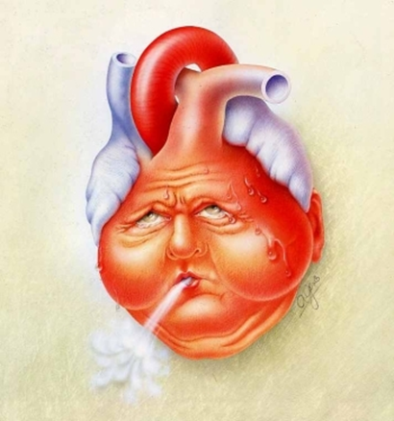
Living with Heart Failure
Chronic Illness
Goal: prevent exacerbation
Changes in daily living
Knowledge and education
Community resources
Support network

Slide 4
Medication Compliance
Take ALL medications as prescribed by MD
Monitor S/E
ACE Inhibitor
Diuretics

Slide 5
Daily Weights
Monitor weight every morning using a scale
Notify your MD if weight gain 2-3lbs over night or 3-5lbs in one week
First sign on fluid retention
Keep a log of weights to review with MD/RN

Slide 6
1 Liter Fluid Restriction
Restrict ALL fluid intake to 1liter per day
Keep strict intake and output
Importance of restricting fluid with weakened heart
Creative ways to measure 1Liter/day

Slide 7
Smoking Cessation
No Smoking
Vasoconstriction
Community support networks to quit smoking cigarettes, cigars, drugs

Slide 8
Heart Healthy Eating
Heart Healthy Diet
Low Salt
Low Cholesterol
Low Carbohydrates
Vegetables/Fruits
Balanced diet
Nutritionist consult

Slide 9
Follow – up
Always follow up with your primary physician / cardiologist
Monitor EKG
Testing: Echo and Stress Test to determine ejection fraction
ASK QUESTIONS!

Slide 10
Nursing’s Role
RN Homecare
Tele-health monitoring
Educate patients and families on signs/symptoms of HF exacerbation
Provide support & establish patient support networks
Maintain rapport

Slide 11
How Will YOU prepare your patients to leave the hospital with HF? How will YOU support your HF patient while in the community?

